Slide 1
Hadoop MapReduce
How to Survive Out-of-Memory Errors
The International Summer Undergraduate Research Fellowship
Faculty Mentor: Professor Harry Xu Student Mentor: Khanh Nguyen Member: Yoonseung Choi
Soyeong Park
Notes:
Anteater is so cute

Slide 2
References
[1] Jeffrey Dean and Sanjay Ghemawat. (2004). “MapReduce: Simplified Data Processing on Large Clusters”. [Online]. Available: http://static.googleusercontent.com/media/research.google.com/ko//archive/mapreduce-osdi04.pdf
[2] 한기용, Do it! 직접 해보는 하둡 프로그래밍. Seoul: EasysPublishing, 2013.
[3] Lijie Xu, “An Empirical study on real-world OOM cases in MapReduce jobs, Chinese Academy of Sciences.
[4] Donald Miner and Adam Shook, MapReduce Design Patterns. O’Reilly Media. Inc, 2012.

Slide 3
Outline
Introduction
What is MapReduce?
How does MapReduce work?
Limitations of MapReduce
Objectives
Operation test
Future work

Slide 4
“There was 5 exabytes of information created between the dawn of civilization through 2003,
But that much information is now created
every 2 days, and the pace is increasing...”
- Eric Schmidt, Google CEO
Notes:
Before the speech
spoke at the Techonomy conference(10’) in Lake Tahoe
http://readwrite.com/2010/08/04/google_ceo_schmidt_people_arent_ready_for_the_tech

Slide 5
Data scientists want
to analyze these
large data sets
How can we handle that?
Distribute processing
But single machine
have
limitations
in processing
these data sets
Do we need to
understand
the details of
parallelization,
fault tolerance,
data distribution
and load balancing?
parallelization
fault tolerance
data distribution
load balancing
Furthermore, data sets
are now growing very rapidly
The answer is ‘no’

Slide 6

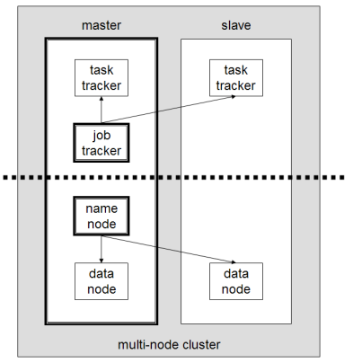
MapReduce is a programming model for processing and generating large data sets
Many real world tasks are expressible in this model
MapReduce Layer
HDFS Layer
The model is easy to use, even for programmers without experience with parallel and distributed systems
* https://en.wikipedia.org/wiki/Apache_Hadoop
[1] Jeffrey Dean and Sanjay Ghemawat. (2004). “MapReduce: Simplified Data Processing on Large Clusters”.

Slide 7
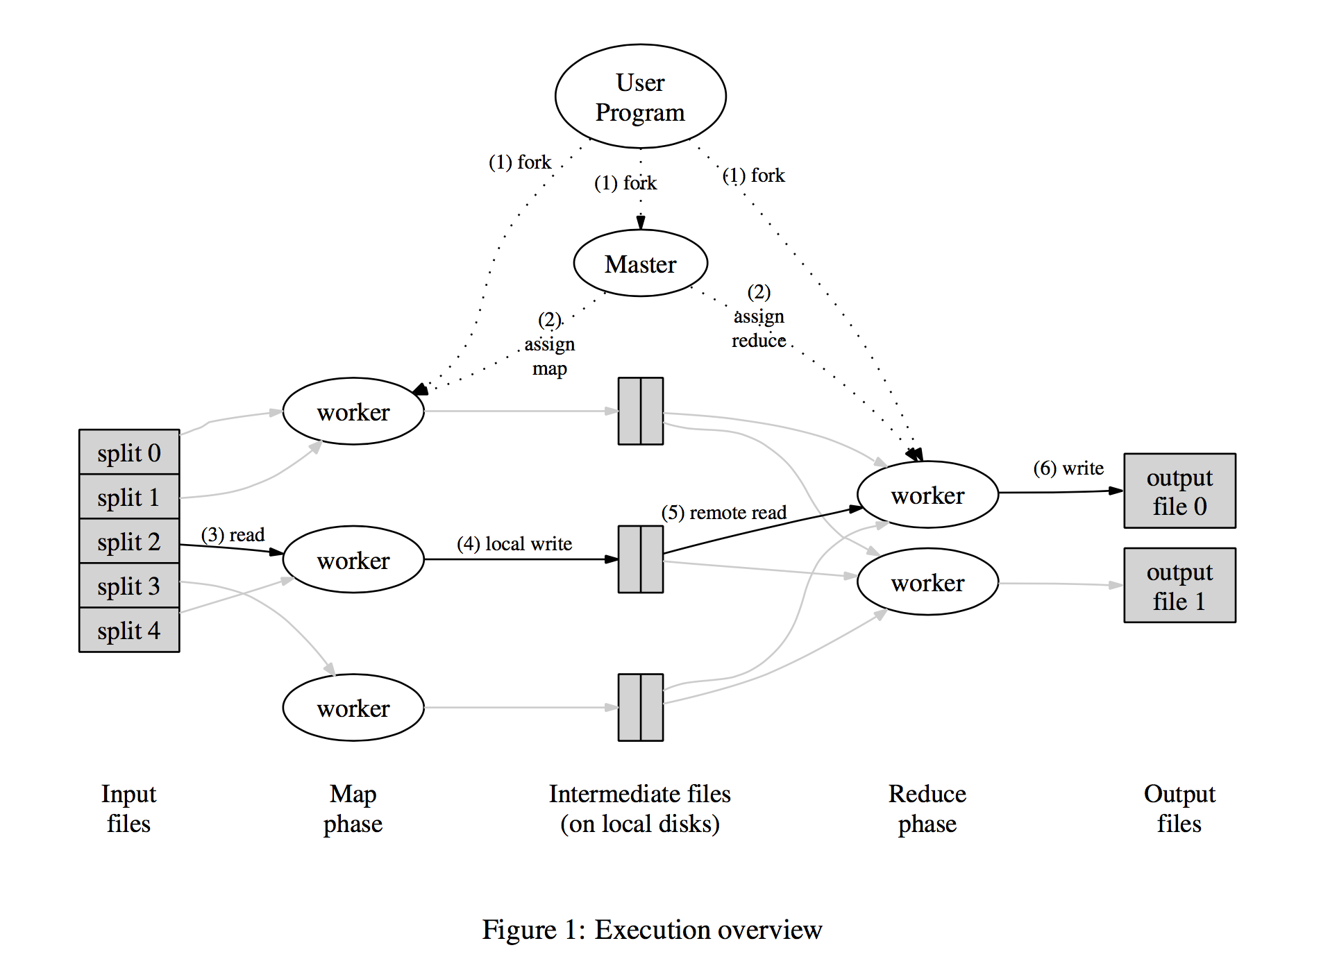
What is MapReduce?
Mapper takes an input
and produces a set of
intermediate key/value pairs
Reducer merges together these
Intermediate values associated
with the same intermediate key
[1] Jeffrey Dean and Sanjay Ghemawat. (2004). “MapReduce: Simplified Data Processing on Large Clusters”. p.12
Notes:
[1, p.12]
* ADD AN ANIMATION

Slide 8
How does MapReduce work?
The cat sees the dog, and the dog sees the cat.
The cat sees the dog
cat, 1
Reduce
Phase
dog, 1
sees, 1
and, 1
Map Phase
the, 2
cat, 2
dog, 2
and, 1
sees, 2
And the dog sees the cat
cat, 1
the, 4
dog, 1
sees, 1
- wordcount program
- sentence is splited
into two map tasks
the, 2

Slide 9
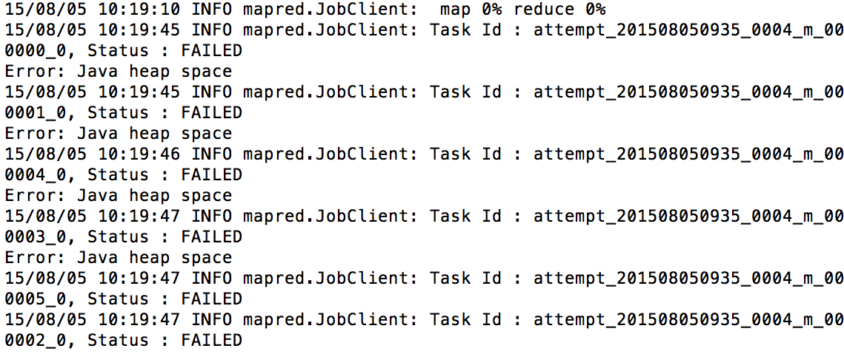
Limitation of MapReduce
Out-of-Memory Errors
High Memory Pressure
Inappropriate Configuration
There are many reasons for poor performance
And even experts sometimes can’t figure them out
Notes:
From now on, next contents are little a bit technical.
So don’t sleep.
Because many programming models which uses MR are generally implemented by managed languages like JAVA or C++
It uses garbage collector and sometimes it make problem

Slide 10
Objectives
Research Out-of-Memory Error cases ……….. done
OOM cases documentation ..…………………… done
Implement and simulate StackOverflow OOM cases
Develop solutions for such OOM cases
Notes:
I want to tell you what we are doing now

Slide 11
Three Categories
Inappropriate Configuration Configuration which causes poor performance
Large Intermediate Results Temporary data structure grows too large
Hot Keys Some keys have a large number of associated values
[3] Lijie Xu, “An Empirical study on real-world OOM cases in MapReduce jobs, Chinese Academy of Sciences.
Notes:
We research some papers, and there’re some patterns which make an OOM. And we can categorize this patterns into 3 categories.

Slide 12
Inappropriate Configuration
# | Asked date | Question Title | Summary of Question | Summary of Solution
42 | Dec 11 '11 at 12:42 | out of Memory Error in Hadoop | I am getting the following Exeception: java.lang.OutOfMemoryError: Java heap space | Assign more memory by editing the conf/mapred-site.xml
48 | Mar 25 '13 at 7:43 | Error: Java heap space | In log, I am getting the error as: Status : FAILED Error: Java heap space | you shall try to increase that heap size export HADOOP_OPTS="-Xmx4096M”. and mapred.child.java.optsbe ‘Xmx4096m’
#42: http://stackoverflow.com/questions/8464048/out-of-memory-error-in-hadoop/13412617#13412617
#48: http://stackoverflow.com/questions/15609909/error-java-heap-space

Slide 13
Large Intermediate Results
# | Asked date | Question Title | Summary of Question | Summary of Solution
15 | Oct 21 '13 at 9:28 | Detailed dataflow in hadoop's mapreduce? | 4 map slots with 900MB heap and 2 reduce slots with 3GB heap. io.sort.mb is 500 MB The job crashed due to Out of Disk Space, using more than available 3TB | A solution for me could be to change the mapred.local.dir to an external storage. DFS will have plenty of room to do the rest of the job.
21 | Oct 11 '12 at 1:52 | OOM exception in Hadoop Reduce child | I tried to increase the value of mapred.reduce.child.java.opts to 1024M but that doesn't help. | You'll need to look into a custom output format so you don't accumulate the values in memory.
#15: http://stackoverflow.com/questions/19490723/detailed-dataflow-in-hadoops-mapreduce
#21: http://stackoverflow.com/questions/12831076/oom-exception-in-hadoop-reduce-child

Slide 14
Hot Keys
# | date | Title | Summary
27 | Dec 11 '11 at 12:42 | Efficient Sharded Positional Indexer | For frequent terms such as "the", the reducer output record may exceed the memory limit of the JVM, Hadoop keeps the whole record (in this case the whole postings list for "the") in memory before sending it to disk. One way to avoid such error is to partition these large postings into manageable sized chunks, and output several records for the same key (the word "the").
#27: http://www.cs.cmu.edu/~lezhao/TA/2010/HW2/

Slide 15
Operation test environments
Standalone & Pseudo-distributed mode - ‘14 MacBook Pro, 2.8 GHz Intel Core i5 8GB 1600 MHz DDR3, 500GB HDD - ‘12 MacBook Air 1.4, GHz Intel Core i5 4GB 1600 MHz DDR3, 256GB HDD
Fully-distributed mode - Raspberry Pi 2 Model B (3 nodes) A quad-core ARM Cortex-A7 CPU (1Ghz Overclock) 1GB 500MHz SDRAM, 64GB HDD, 100Mbps Ethernet

Slide 16
Single node Operation test
Input: StackOverflow’s users profiles (1GB)
Test program: average users’ age based on countries
1 Mapper & 1 Reducer for Standalone mode
2 Mapper & 2 Reducer for Pseudo-distributed mode
Running time(s)
Split size (MB) | Running time(s)
 | Stand alone | Pseudo distributed
16 | 172 | 199
32 | 87 | 112
64 | 46 | 89
128 | 28 | 54
256 | 25 | 71
Split
size
* 12’ MacBook Air 1.4, GHz Intel Core i5, 4GB 1600 MHz DDR3, 256GB HDD
Notes:
Show just running time decrease

Slide 17


Fully-distributed Operation test
Input: StackOverflow’s users profiles (1GB)
Test program: average users’ age based on countries
Running
time(s)
Split
size
Split size |  | 32MB | 64MB | 128MB | 256MB
Running time | 6 Mapper | 375s | 396s | 442s | 548s
 | 12 Mapper | 313s | 296s | 350s | 557s
* Raspberry Pi 2 Model B (3 nodes) A quad-core ARM Cortex-A7 CPU (1Ghz Overclock) 1GB 500MHz SDRAM, 64GB HDD, 100Mbps Ethernet
800MHz (6M6R) | 32MB | 64MB | 128MB | 256MB
1st | 8m28s | 8m32s | 10m0s | 12m46s
2nd | 8m35s | 8m44s | 9m58s | 12m14s
3rd | 8m33s | 8m59s | 10m13s | 13m38s
Avg. | 8m32s | 8m45s | 10m4s | 12m53s
[master]
[worker1]
100Mbps
Ethernet
[worker2]
Notes:
Why graph grows?
Because 256 split size has just 4 map tasks
It means 2 of 6 mapper will not work.
So we need more bigger

Slide 18
Future work
Implement and simulate StackOverflow OOM cases
Develop solutions for such OOM cases

Slide 19
Thank You
And if you want to know more technical information, please enter to our GitHub repository.
https://github.com/I-SURF-Hadoop/MapReduce

Slide 20
appendix
How does MapReduce really work?

Slide 21
How does MapReduce work?
The cat sees the dog, and the dog sees the cat.
The cat sees the dog
the, 1
Combining & Sorting
[ Map Phase ]
cat, 1
cat, 1
MapReduce library first splits the input into M pieces.
A map worker processes these pieces using user-defined Map function. Intermediate key/value pairs will be produced by this function.
sees, 1
dog, 1
the, 1
sees, 1
dog, 1
the, 2

Slide 22
How does MapReduce work?
The cat sees the dog, and the dog sees the cat.
cat, 1
Shuffling
[ Reduce Phase ]
dog, 1
and, 1
sees, 1
When a reduce worker has read all intermediate data, it sorts them by the intermediate keys.
The reduce worker iterates the sorted intermediate data and for each unique intermediate key encountered, it passes the key and the values to the user’s Reduce function.
cat, 2
the, 2
dog, 2
and, 1
sees, 2
cat, 1
the, 4
dog, 1
sees, 1
the, 2
Two independent reducer

